Slide 1
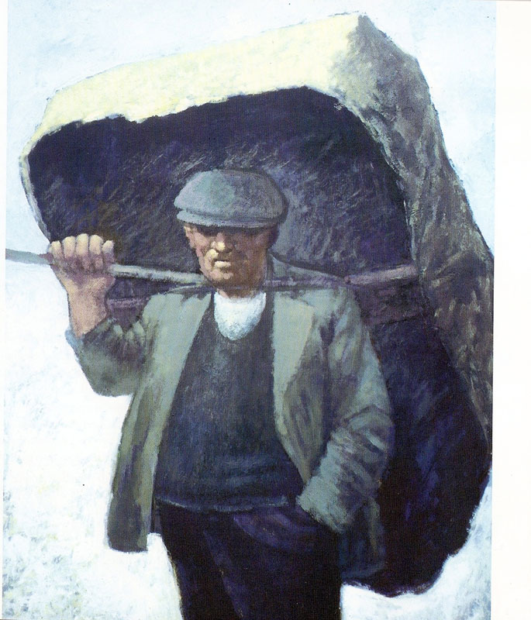
Used with kind permission of Aneurin Jones
A series of interactive lessons and instructions for teachers to create a art project:
Years 5 a 6
Lesson 11
Workers and the workhouse during Victorian Times
Next page
Notes:
1

Slide 2
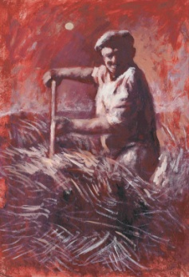
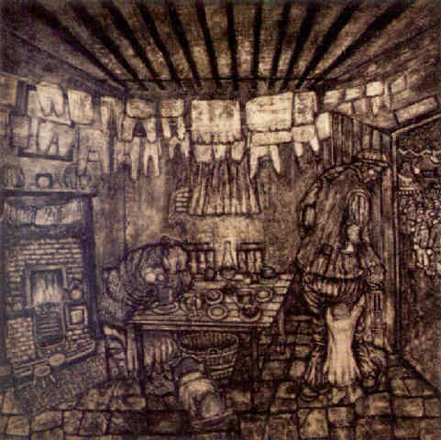
Mixing paint to create tones
Task: To experiment by mixing paint to create colours and tones that suit the period.
As you mix the paint, remember that you task is to copy the style of Aneurin Jones and Nicholas Evans by trying to paint with a limited palette.
Your teacher is looking for an extensive palette of colours and tones of paint by using only 3 or 4 colours to mix. You must also have good use of light and shadow to create mood.
Previous page
Used with kind permission of Aneurin Jones a Nicholas Evans
Next page

Slide 3
Mixing paint to create tones
More white paint
Skill used:
Mix paint
Create different tones
Create mood to the piece including light and shadow.
Original colour
Medium used:
Paint
More black paint
Previous page

